Slide 1
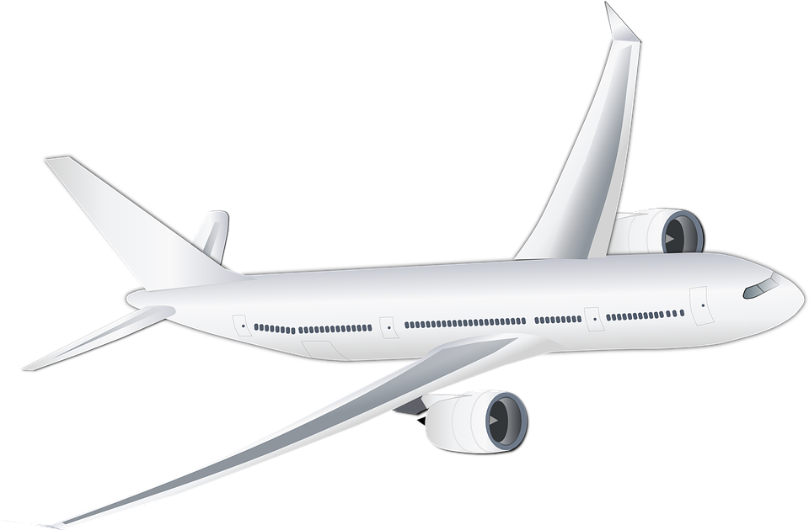
Airline Safety
By Saurabh Shrestha

Slide 2
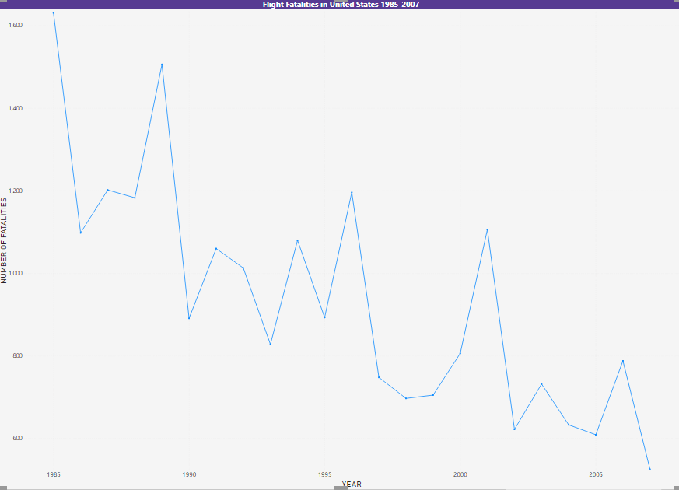
Flight Fatalities from 1985 - 2007
Out of the 36,096 highway fatalities in 2019, 12,239 were occupants in car, 9,976 were occupants in small trucks, and 5,014 were motorcyclists.
Compared to highway fatalities air fatalities are comparatively lower with 452 in 2019.
Decrease in fatalities thanks to advanced technologies.

Slide 3
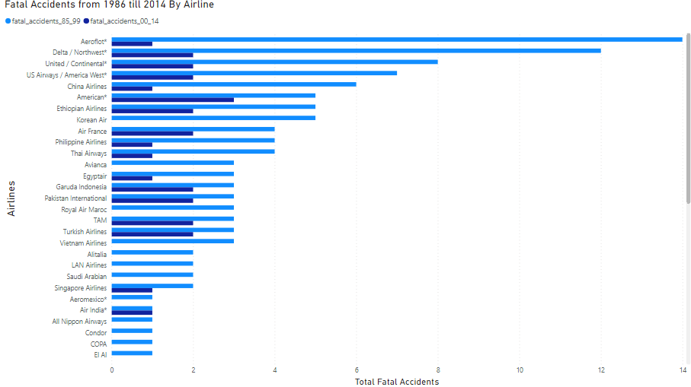
Rate of Fatal Events by Airlines

Slide 4
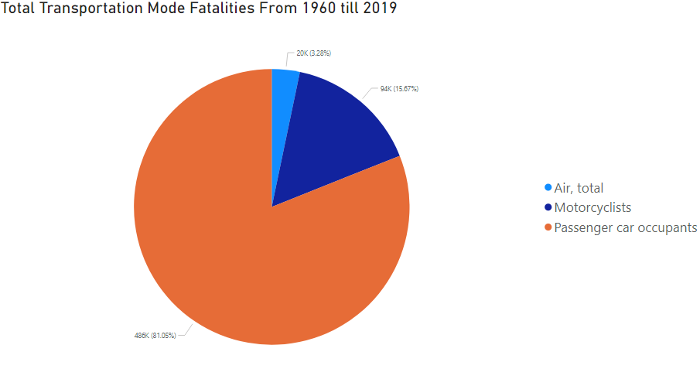
Transportation Fatalities 1960 - 2019
Passenger car occupants fatalities is over 80%.
Motorcyclists fatalities is over 15%
Air fatalities is mere 3%.

Slide 5
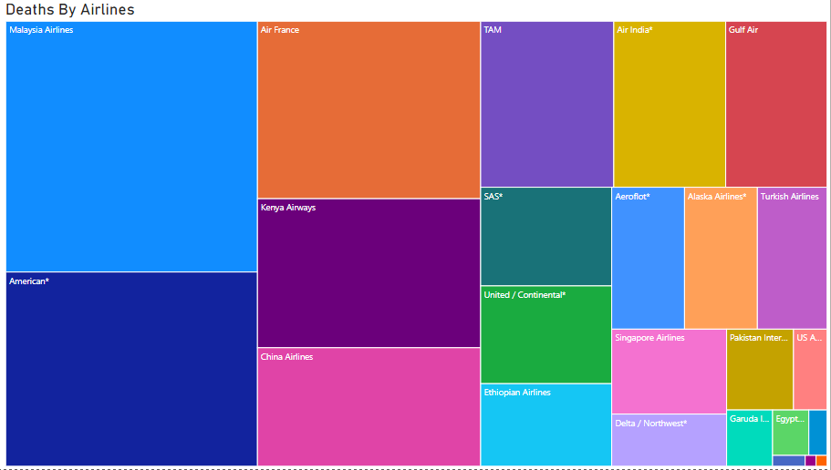
Deaths By Each Airline
Malaysian airlines had the highest death in International airlines.
American airlines had the highest death occurrence in USA airlines.
Reason for American airlines staggering deaths could be because it carries maximum passenger in the world – 215 million in 2019.

Slide 6
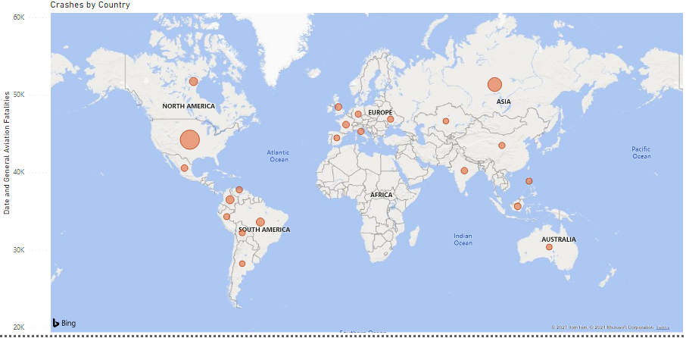
Aviation Fatalities By Country
USA had the highest fatalities.
European countries fall behind USA in terms of fatalities.
Could be contributed to number of passengers each country carry.

Slide 7
Travel (Ever vs Past Year)
Based on travel there is increase in new customers.
For comparing to past there year there is a little slow decline in customers.
Year | Ever | Past Year
2015 | 81 | 54
2016 | 89 | 49
2017 | 88 | 48
2018 | 87 | 47
2019 | 86 | 45

Slide 8
Passenger Satisfaction In Recent Years
It is an aggregate of a representative number from customer interviews.
Airline passengers are considerably satisfied with their flights.
Southwest has highest satisfaction among other major airlines
Lowest satisfaction comes from American Airlines.
Airlines | 2014 | 2015 | 2016 | 2017 | 2018 | 2019 | 2020 | 2021
Southwest | 81 | 78 | 78 | 80 | 80 | 80 | 79 | 79
All Others | 72 | 70 | 73 | 74 | 74 | 73 | 71 | 70
Delta | 68 | 71 | 71 | 71 | 76 | 74 | 75 | 77
United | 62 | 60 | 60 | 68 | 70 | 67 | 70 | 75
US Airways | 64 | 66 | #
American | 65 | 66 | 66 | 72 | 76 | 74 | 73 | 0

Slide 9
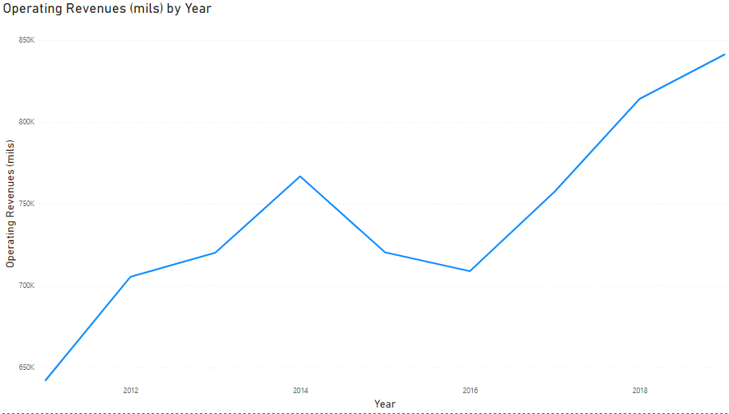
Operating Revenue By Year
Rapid increase in revenue from 2016.
2011 operating revenue was 642,100 million dollars
2019 operating revenue was 841,340 million dollars

Slide 10
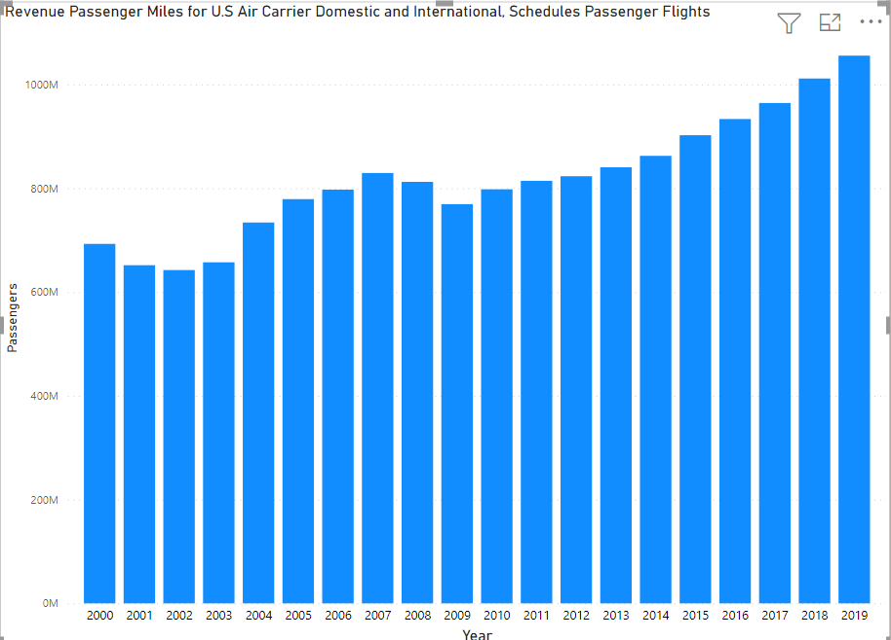
Revenue Passenger Miles
A revenue passenger-mile is equal to one paying passenger carried one mile.
Since 2009 with the highest being in 2019 with 101,794,185,000 in revenue passenger-miles.
Airline news does not seem to be affecting travel.

